Slide 1
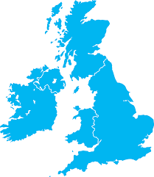
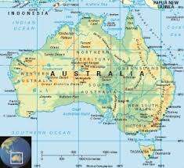
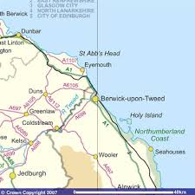
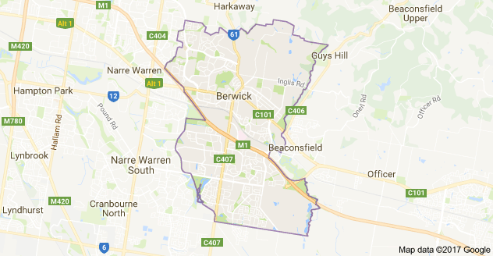
Berwick Upon Tweed
England
United Kingdom
Berwick Upon Tweed
City in Victoria
Australia
Elm Class
Summer Term
2017
Compare and Contrast small areas of the UK to an area of a non- European Country

Slide 2
We will find out where both towns /countries are in the world using Google Maps
We will find out about different types of food eaten in each country
We will look at the animals that live in both countries
We will find out what the children in Berwick in Australia like to do
We will write a letter to the school children in Berwick Australia and try and find their website
We will find out if there are any beaches in Berwick , Australia
We will find out what the weather is like in both towns
We will find out what the time difference is between each Country
We will look at pictures of both towns to see if they look the same

Slide 3
Useful websites
https://www.travelvictoria.com.au/berwick/weather/
http://www.thebuzzaroundberwick.com.au/
https://www.tripadvisor.co.uk/Tourism-g552140-Berwick_Greater_Melbourne_Victoria-Vacations.html
http://www.visitnorthumberland.com/berwick-upon-tweed
http://www.visitberwick.com/
http://www.undiscoveredscotland.co.uk/berwick/berwickupontweed/

Slide 4
Display Board 1
Half the board and have two large clocks to show times in both Berwick’s and show a silhouette of the UK and Australia

Slide 5
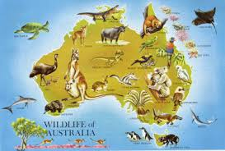
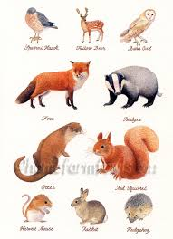
Display Board 2
Compare and Contrast Animals in each country and then look at domestic animals, are they the same?

Slide 6
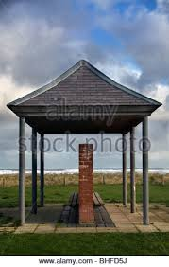
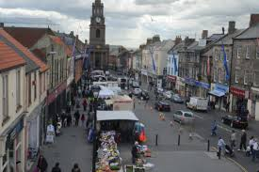
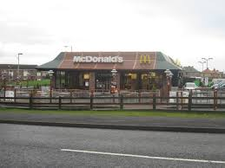
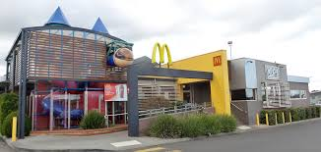
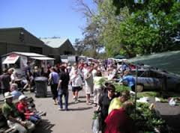
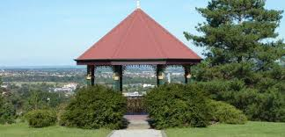
Display Board 3
Compare and contrast places visited on a bus day, take photographs and research similar landmarks in Berwick Australia

