Slide 1
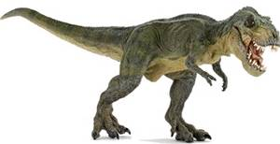
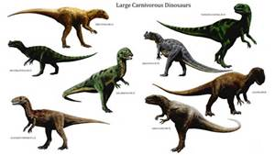
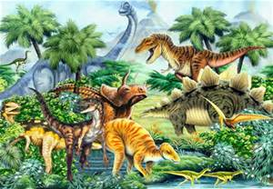
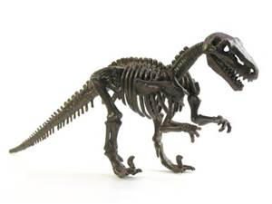
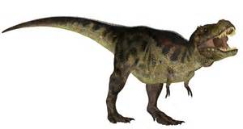
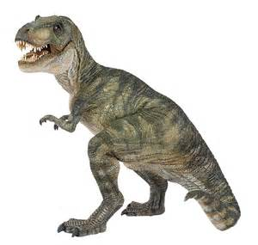
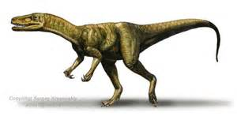
Elm Class
Autumn Term 2016
Dinosaurs

Slide 2
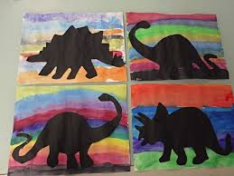
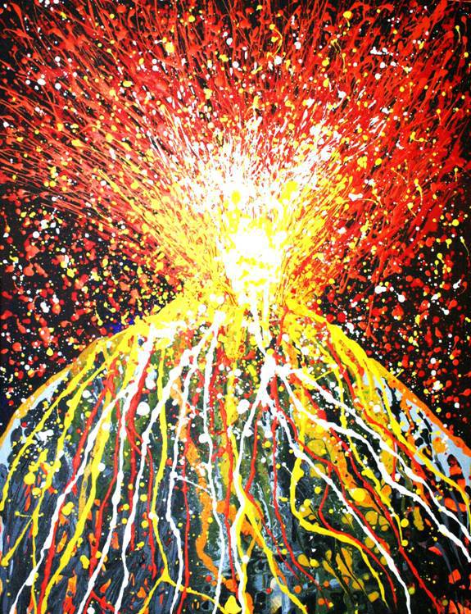
Display Board 1
Use this picture as the inspiration for a whole class picture, children to create the background using sponges and printing materials using rainbow colours.
Silhouette dinosaurs to be added and a volcano with silhouette letters coming out of the volcano like lava(phonics)
Display Board 2
Create splatter paint volcano and surround with photographs of children making their own volcanoes with vinegar and baking soda
Discuss colours
hot/cold
liquid/solid
Children to make chalk representations of the volcano to display alongside his picture

Slide 3
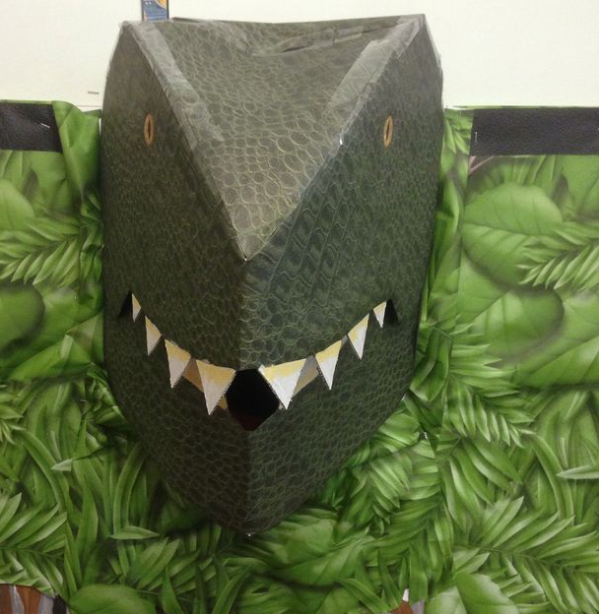
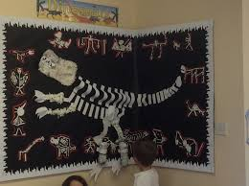
Display Board 3
Display Board in the art room
Using art straws cut short lengths and get the children to build the dinosaur skeletons
Make 3D dinosaur heads from card/paper and boxes and foliage. Add numbers to encourage children to count.
Practice cutting skills to make big dinosaur, children to cut lots of strips of paper
We will make Pterodactyls to hang from the ceiling leaving all of the hanging greenery in place
Children to vote on which dinosaur to create

Slide 4
Being Paleontologists Materials needed: shaving cream, dinosaurs and paint brushes. Cover dinosaurs with shaving cream. Provide spoons and paint brushes for the children to "discover" the dinosaurs! VARIATION: Do this same activity at the art table! Cover a dinosaur with shaving cream. Provide each child with a paint brush to find the dinosaur! You can add paint to the shaving cream and also encourage the children to write in the shaving cream. Prehistoric Bones Place soil or dirt, spoons, cups and chicken bones on the sensory table for some fossil searching! Use paint brushes to brush dirt off the bones. Habitats Materials needed: sand, rocks, plastic plants, toy dinosaurs, dirt/soil. The children use the materials to create a prehistoric habitat! Volcanoes Materials needed: Playdough, shallow trays (1 for each child) pipettes, vinegar, baking soda, goggles Provide playdough for the children to make their own volcanoes. the children use small spoons to put baking soda in their volcano and then use the pipettes to drop vinegar on the baking soda. Dino Swamp Materials needed: paddling pool, dirt and water! In advance, ask parents to send their children old clothes/wellies Make mud in the wading pool and STOMP! Swamp Picture Materials Needed: finger paint paper, brown finger paint, dirt or soil, grass and rubber bands cut into pieces for "worms") Put brown paint in the middle of the paper. Let the children add dirt/soil, grass and worms as they paint! When dry, place them on a table and provide dinosaurs to move in the Swamp pictures! Collage Materials Needed: dino-shaped pasta, scraps of coloured paper, glue, full sheets of construction paper The children use the dino pasta to make a prehistoric collage. The coloured scraps of paper can be used for them to make volcanoes, trees, etc.

Slide 5
We will make dinosaur costumes from large cardboard boxes
We learn the sounds at the beginning of the dinosaur names and may even learn some of the names
We will learn to count and sort dinosaurs
We will learn to mix shades of green and brown
We will have treasure hunts to look for letters and numbers hidden on dinosaurs
Our cooking will have a dinosaur theme
We will learn to move like and make the sounds of the dinosaurs
We will create lots of independent art which our teachers will turn into beautiful displays
We will have fun learning about dinosaurs

Slide 6
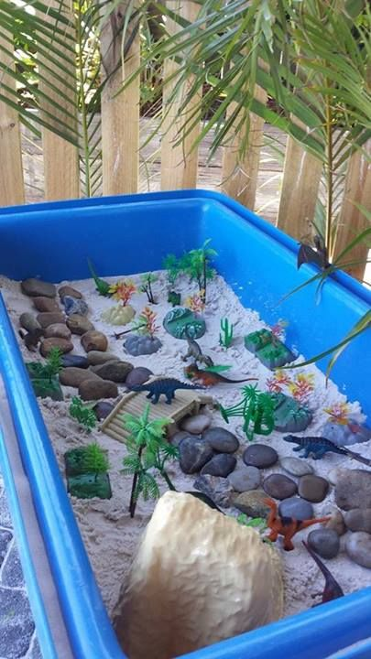
Songs to learn
Turn Around sung to Teddy Bear, Teddy Bear
Dinosaurs, dinosaurs, stomped around.
Dinosaurs, dinosaurs, shook the ground.
Dinosaurs, dinosaurs, gave some fear.
Dinosaurs, dinosaurs, are no longer here!
Five Huge Dinosaurs
Five huge dinosaurs looking fierce and mean.
The first one said "I eat things that are green".
The second one said "I hatched form an egg."
The third one said "I have big, strong lets"
The fourth one said "I can fly through the air"
The fifth one said "I give everyone a scare!"
Thump thump came Tyrannosaurus Rex that day.
And the five huge dinosaurs all ran away!
Around the Prehistoric Swamp (sung to Wheels on the Bus)
The pteranodon's wings went
flap, flap, flap...flap, flap, flap...flap, flap, flap
The pteranodon's wings went flap, flap, flap all around the swamp!
The Tyrannosaurus rex went grr, grr, grr....
The triceratops horns went poke, poke, poke
The stegosaurus' tail went spike, spike, spike....

